Slide 1








Satellite-based Mangrove species abundance estimate using Machine Learning ensemble
Hastuadi Harsa, Gathot Winarso, Kuncoro Teguh Setiawan and Wikanti Asriningrum
Remote Sensing Research Center - Research Organization for Aeronautics and Space
Indonesia National Research and Innovation Agency

Slide 2

01
Introduction

Slide 3
Carbon trading serves as a climate change mitigation strategy.
Mangrove forests are known for their exceptional capacity to store carbon.
Accurately estimating the carbon stock of mangrove forests requires understanding the different carbon sequestration potentials among various mangrove species.
Remote sensing techniques, particularly satellite imagery, have revolutionized ecological studies by providing a cost-effective and efficient means of mapping large areas.
Integrating satellite imagery with Machine Learning (ML) algorithms allows for advanced analysis of spectral bands to predict mangrove species, aiding in species-specific carbon stock calculations

Slide 4
02
Objective

Slide 5
Utilizing ML for predicting mangrove species from Landsat satellite imagery bands.
Estimating the coverage area of each mangrove species.

Slide 6
03
Study area

Slide 7
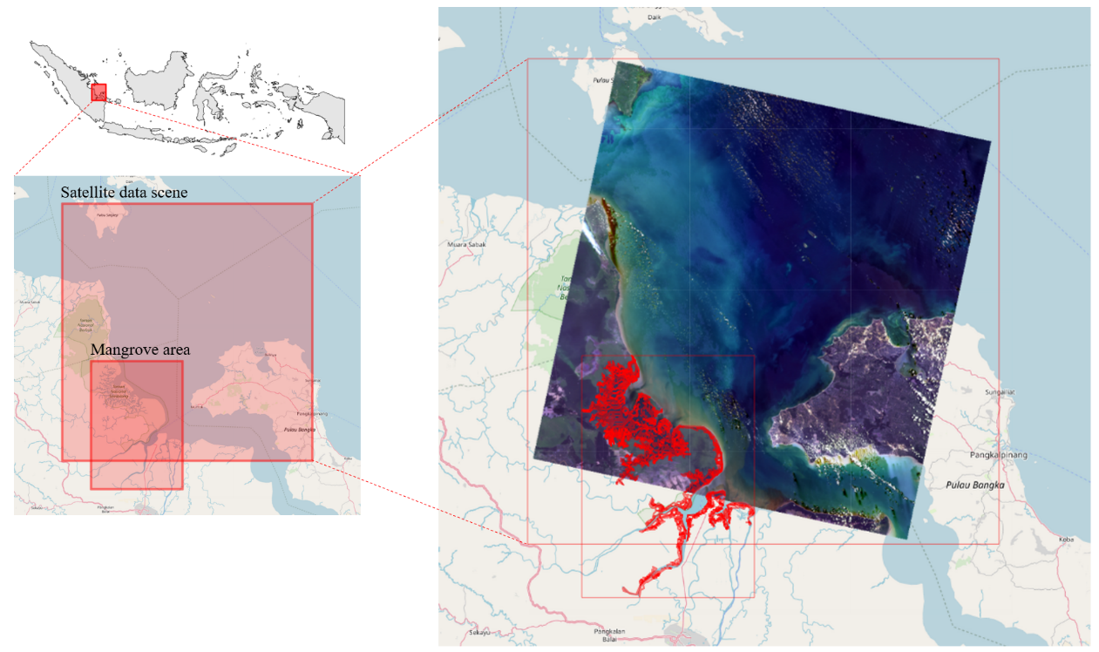
Sembilang National Park in Banyuasin Regency, along the east coast of Sumatra, Indonesia.

Slide 8
04
Data

Slide 9
1. Mangrove area
Obtained from the Indonesia Ministry of Environment and Forestry (Kementerian Lingkungan Hidup dan Kehutanan / KLHK).
Represented as vector polygon file (SHP).
Determined the boundary of the mangrove area.
2. Field observation
Collected within the mangrove area.
Obtained using a spectrometer instrument.
Recorded the spectral measurement values of mangrove leaf at selected sampling locations.
The broadest species was selected as a surrogate within each sampling neighborhood.
8 variables were recorded: 7 band spectrums and their corresponding species name.
There were 21 species found within the study area.
3. Satellite data
Landsat 8.
30 meter in resolution.
Values were extracted at mangrove area polygon.
Contained 7 bands.

Slide 10
05
Method

Slide 11
1. Data pre-processing
Radiometric correction of satellite data.
Standardization.
2. Model building
Provide 20 cross validation (CV) dataset from field observation data:
Independent variables: 7 bands spectrum.
Dependent variable: species name.
Train various ML algorithms using 20 CV dataset:
Algorithms: (Distributed Random Forest (DRF), Generalized Linear Model (GLM), Extreme Gradient Boosting (XGBoost), Generalized Boosting Models (GBM), and Deep Learning (DL).
Total training period: 2 hours for various algorithm-specific parameter settings for each algorithm.
Evaluate model performances
Select the best model.
3. Model implementation
Apply the best model for predicting mangrove species using satellite 7 bands.
Tabulate the number of pixels for each predicted species.
Calculate species abundance in percentage and Ha.

Slide 12
06
Results

Slide 13
The number of model generated: 466
Best model: stacked ensemble of six base models: DL, two DRFs, GBM, GLM, and XGBoost.
The accuracy* of the best model:
Mean for all CV datasets; 95.04%,
Mean of per-class for all CV datasets; 94.8%,
*accuracy: the number of correct species prediction divided by the number of data.

Slide 14
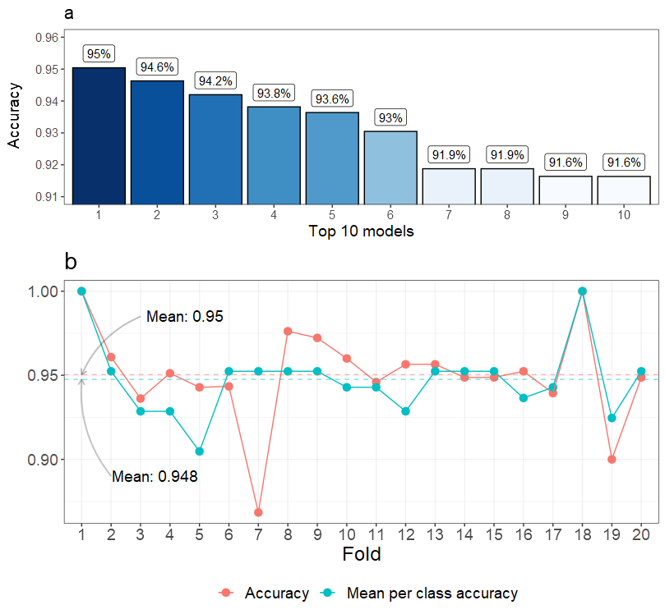
(a) the top-10 best models out of 466, sorted by their accuracy,
(b) best model accuracy in each fold.

Slide 15
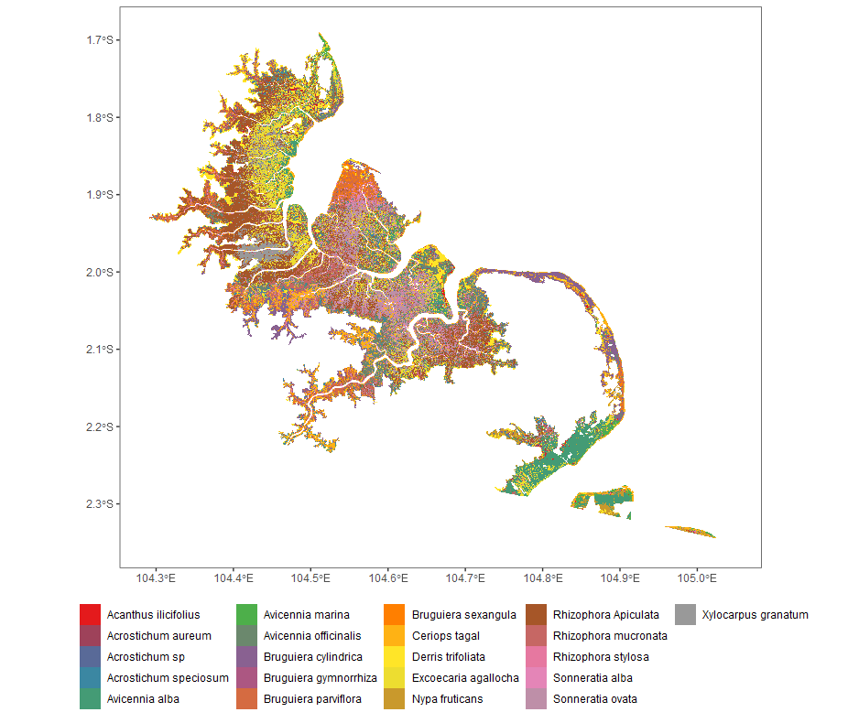

Slide 16
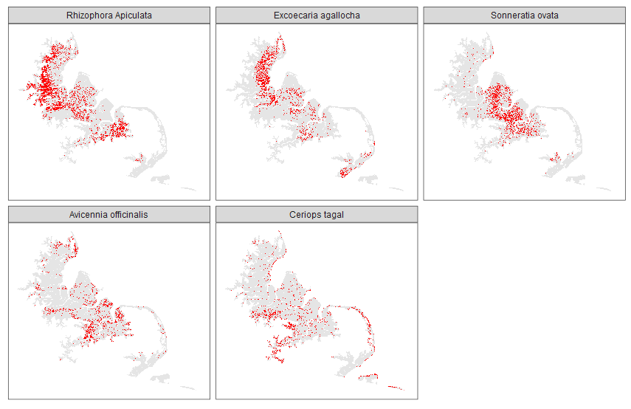
The distribution of the top-5 most abundant species.

Slide 17
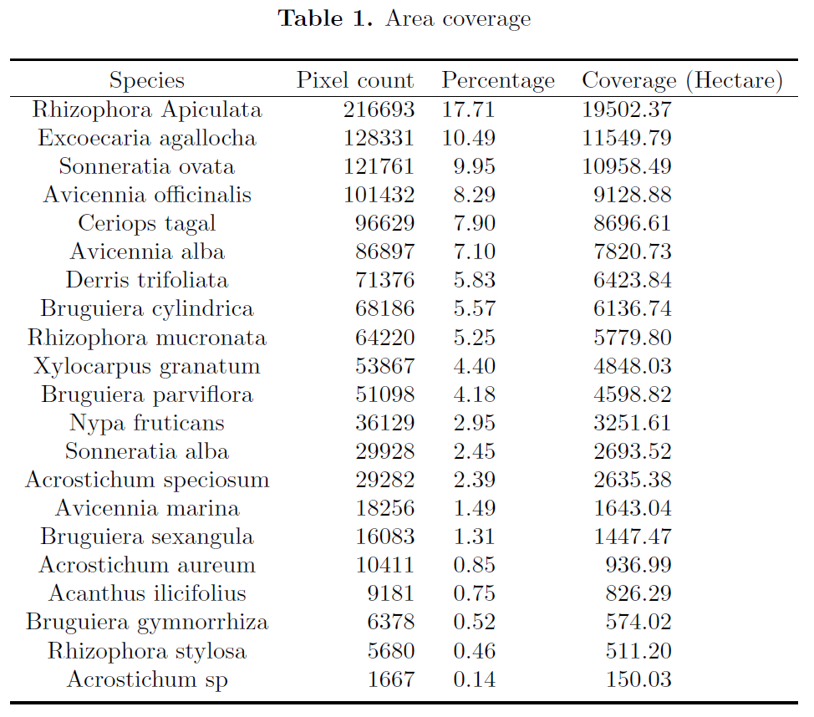

Slide 18
07
Conclusion

Slide 19
An estimate method of mangrove species abundance has been presented in this paper.
The method applied some ML Machine Learning (ML) algorithms to provide species classification models.
The algorithms used mangrove species spectrum data from field observation as their learning materials.
Some best ML models were then ensembled to develop a better model.
The best model achieved a mean accuracy value of 95% when tested on observation data.
The best model was then implemented as a classifier of Landsat satellite data.
Rhizophora Apiculata and Excoecaria agallocha are the two most abundant mangrove species, covering 17.71% (19502.37 Ha) and 10.49% (11549.79 Ha), respectively.
By quantifying the abundance of mangrove species, the amount of carbon sequestered can also be further computed as a consideration factor in carbon trading.

Slide 20
Thank you
hastuadi.harsa@brin.go.id

Slide 21
08
References

Slide 22
[1] Y. Zheng and W. Takeuchi, "Estimating mangrove forest gross primary production by quantifying environmental stressors in the coastal area," Scientific Reports, vol. 12, p. 1–14, February 2022.
[2] Y. Zheng, R. Tan and B. Zhang, "The joint impact of the carbon market on carbon emissions, energy mix, and copollutants," Environmental Research Letters, vol. 18, p. 045007, 2023.
[3] S. Xu, W. Pan and D. Wen, "Do carbon emission trading schemes promote the green transition of enterprises? Evidence from China," Sustainability, vol. 15, p. 6333, April 2023.
[4] C. J. Wong, D. James, N. A. Besar, K. U. Kamlun, J. Tangah, S. Tsuyuki and M.-H. Phua, "Estimating mangrove above-ground biomass loss due to deforestation in Malaysian northern Borneo between 2000 and 2015 using SRTM and Landsat images," Forests, vol. 11, p. 1018, September 2020.
[5] D. Wang, B. Wan, P. Qiu, Z. Zuo, R. Wang and X. Wu, "Mapping height and aboveground biomass of mangrove forests on Hainan island using UAV-Lidar sampling," Remote Sensing, vol. 11, p. 2156, September 2019.
[6] C. F. A. Sondak, E. Y. Kaligis and B. Robert A, "Economic valuation of Lansa Mangrove forest, North Sulawesi, Indonesia," Biodiversitas, vol. 20, p. 978–986, March 2019.
[7] M. Scott, Machine Learning: Unsupervised and Supervised Learning, 2023.
[8] T. Pham, N. Yokoya, D. Bui, K. Yoshino and D. Friess, "Remote sensing approaches for monitoring mangrove species, structure, and biomass: opportunities and challenges," Remote Sensing, vol. 11, p. 230, January 2019.
[9] J. A. Navarro, N. Algeet, A. Fernández-Landa, J. Esteban, P. Rodríguez-Noriega and M. L. Guillén-Climent, "Integration of UAV, Sentinel-1, and Sentinel-2 data for mangrove plantation aboveground biomass monitoring in Senegal," Remote Sensing, vol. 11, p. 77, January 2019.
[10] S. Nasir, H. Muhammad and S. A. Novi, "Modeling mangrove ‘blue carbon’ ecosystem service in Jakarta bayas an impact of coastal development," E3S Web of Conferences, vol. 73, p. 04023, 2018.
[11] C. Molnar, Interpretable Machine Learning, A Guide for Making Black Box Models Explainable, Independently Published, 2023.
[12] R. Mitchell and E. Frank, "Accelerating the XGBoost algorithm using GPU computing," PeerJ Preprints, April 2017.
[13] M. Malohlava, A. Candel, C. Click, H. Roark and V. Parmar, Gradient Boosting Machine with H2O, A. Bartz, Ed., H2O.ai, Inc., 2023.
[14] Y. Maeda, A. Fukushima, Y. Imai, Y. Tanahashi, E. Nakama, S. Ohta, K. Kawazoe and N. Akune, "Estimating carbon stock changes of mangrove forests using satellite imagery and airborne lidar data in the South Sumatra state, Indonesia," The International Archives of the Photogrammetry, Remote Sensing and Spatial Information Sciences, Vols. XLI-B8, p. 705–709, June 2016.

Slide 23
[15] C. Ma, B. Ai, J. Zhao, X. Xu and W. Huang, "Change detection of mangrove forests in coastal Guangdong during the past three decades based on remote sensing data," Remote Sensing, vol. 11, p. 921, April 2019.
[16] E. LeDell and S. Poirier, "H2O AutoML: Scalable Automatic Machine Learning," 7th ICML Workshop on Automated Machine Learning (AutoML), 2020.
[17] G. Lassalle and C. R. deSouza Filho, "Tracking canopy gaps in mangroves remotely using deep learning," Remote Sensing in Ecology and Conservation, vol. 8, p. 890–903, December 2022.
[18] S. Ke, Z. Zhang and Y. Wang, "China's forest carbon sinks and mitigation potential from carbon sequestration trading perspective," Ecological Indicators, vol. 148, p. 110054–, April 2023.
[19] X. Jiang, J. Zhen, J. Miao, D. Zhao, Z. Shen, J. Jiang, C. Gao, G. Wu and J. Wang, "Newly-developed three-band hyperspectral vegetation index for estimating leaf relative chlorophyll content of mangrove under different severities of pest and disease," Ecological Indicators, vol. 140, p. 108978–, July 2022.
[20] A. J. Hsu, J. Kumagai, F. Favoretto, J. Dorian, B. G. Martinez and O. Aburto-Oropeza, "Driven by drones: improving mangrove extent maps using high-resolution remote sensing," Remote Sensing, vol. 12, p. 3986, December 2020.
[21] M. Ghorbani, F. Salmasi, M. Saggi, A. Bhatia, E. Kahya and R. Norouzi, "Deep learning under H2O framework: A novel approach for quantitative analysis of discharge coefficient in sluice gates," Journal of Hydroinformatics, vol. 22, p. 1603–1619, September 2020.
[22] P. Geurts, D. Ernst and L. Wehenkel, "Extremely randomized trees," Machine Learning, vol. 63, p. 3–42, March 2006.
[23] S. Gandhi and T. Jones, "Identifying mangrove deforestation hotspots in South Asia, Southeast Asia and Asia-Pacific," Remote Sensing, vol. 11, p. 728, March 2019.
[24] A. S. Elsayad, A. I. E. Desouky, M. Salem and M. Badawy, "A Deep Learning H2O Framework for Emergency Prediction in Biomedical Big Data," IEEE Access, vol. 8, p. 97231–97242, 2020.
[25] P. K. Dunn and G. K. Smyth, "Series evaluation of Tweedie exponential dispersion model densities," Statistics and Computing, vol. 15, p. 267–280, October 2005.
[26] C. Click, J. Lanford, M. Malohlava, V. Parmar and H. Roark, Gradient Boosted Machines with H2O, H2O.ai, Inc., 2015.
[27] T. Chen and C. Guestrin, "XGBoost," Proceedings of the 22nd ACM SIGKDD International Conference on Knowledge Discovery and Data Mining, August 2016.
[28] K. Cetera, "Recognition of Forest Carbon Rights in Indonesia: A Constitutional Approach," Lentera Hukum, vol. 9, p. 151–176, April 2022.

Slide 24
[29] A. Candel and V. Parmar, Deep Learning with H2O, 2307 Leghorn StreetMountain View, CA 94043: H2O.ai, Inc., 2015.
[30] B. Boehmke and B. M. Greenwell, Hands-on Machine Learning with R, 1st edition, Chapman and Hall/CRC, 2020, p. 488.
[31] T. Atmaja, K. Fukushi and K. Fukushi, "Empowering geo-based AI algorithm to aid coastal flood risk analysis: a review and framework development," ISPRS Annals of the Photogrammetry, Remote Sensing and Spatial Information Sciences, Vols. V-3-2022, p. 517–523, May 2022.

Slide 25
09
Software

Slide 26






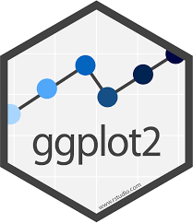






1. Main
2. Editor
3. R packages
Tabular data processing
Raster and vector data processing
Machine Learning
Visualization
Documentation
4. Writing

